Slide 1
Lab 4 : Multi-Digit Up Counter
Sami Elias, Joseph Popoviciu

Slide 2
Objective
Create an up counter that counts from 0 to 9 for multiple digits.
The counter must go back to 0 after reaching 99
It must feature an enable switch
The counter must be displayed on a seven segment display with changing speeds based on a 5-bit select multiplexer

Slide 3
Clock divider
We included a clock divider that slows down the counter based on a 5-bit input.
It is implemented using a
The left is the most significant digit
The right is the least significant digit

Slide 4
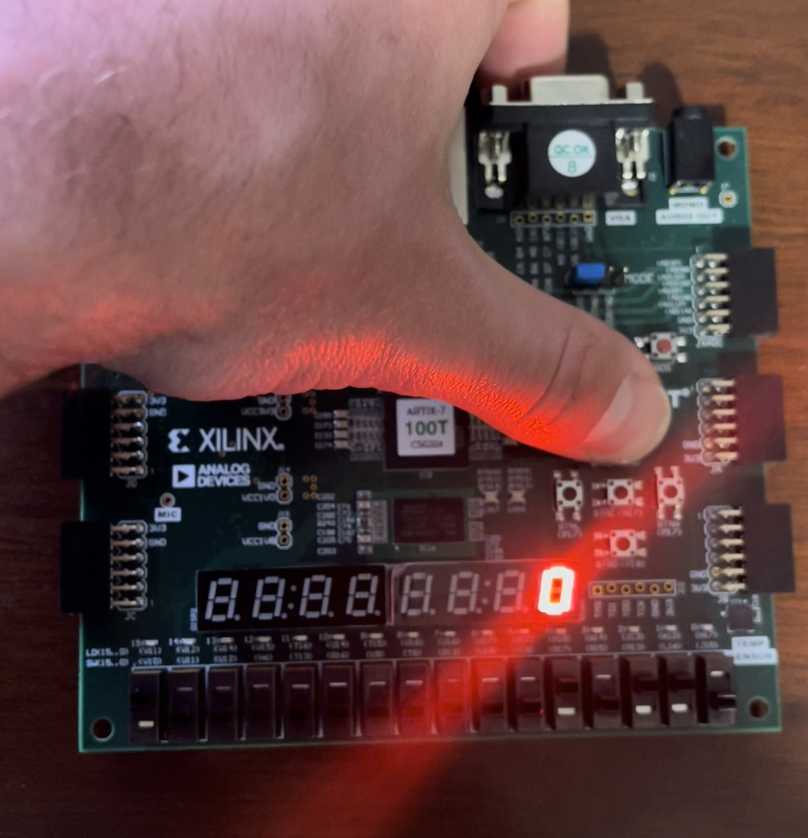
Reset switch
The reset button will set the counter to 0
Reset works whether the enable is low or high

Slide 5
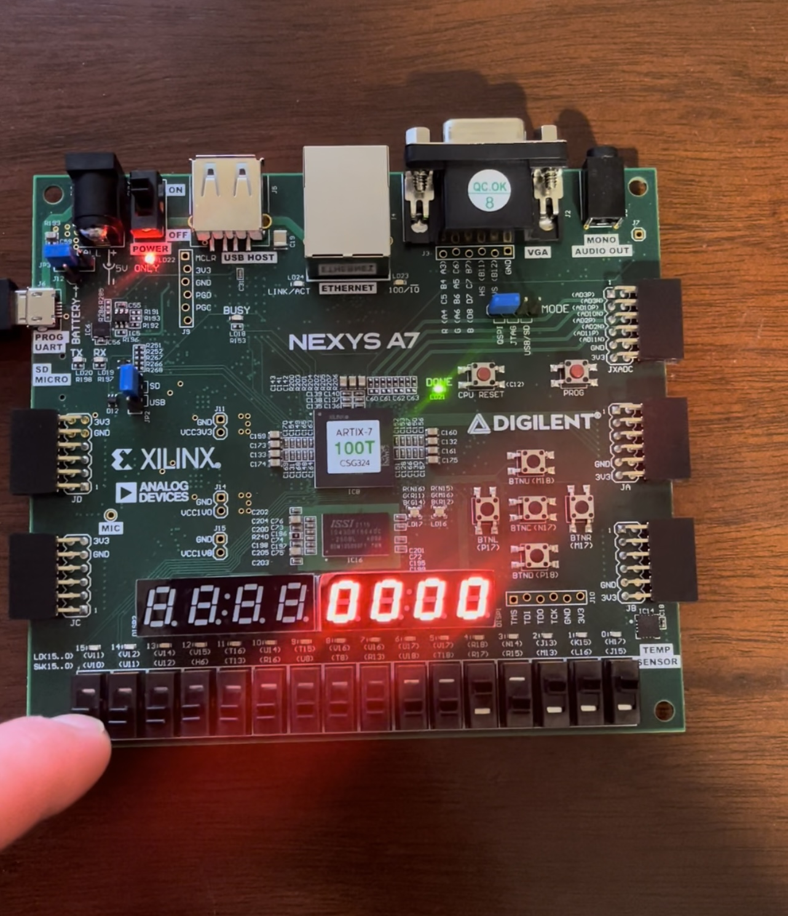
Enable
The enable switch is the left most switch
The count will only proceed if the enable is high
If at any point the enable is switched to low during the count, the count will freeze in place

Slide 6
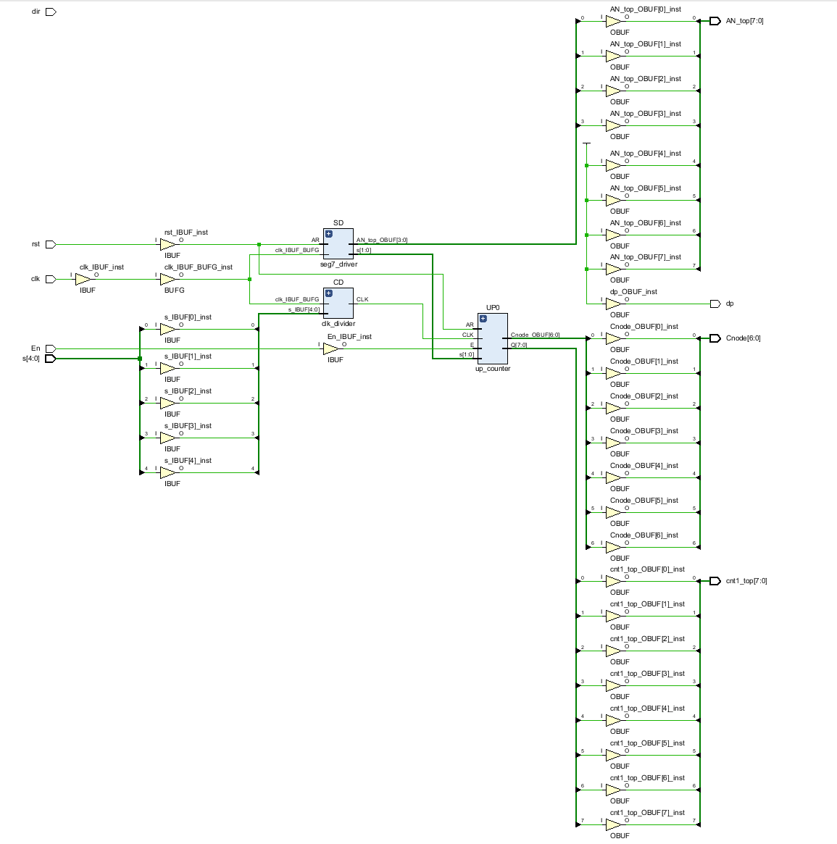
Schematic Implementation

Slide 7
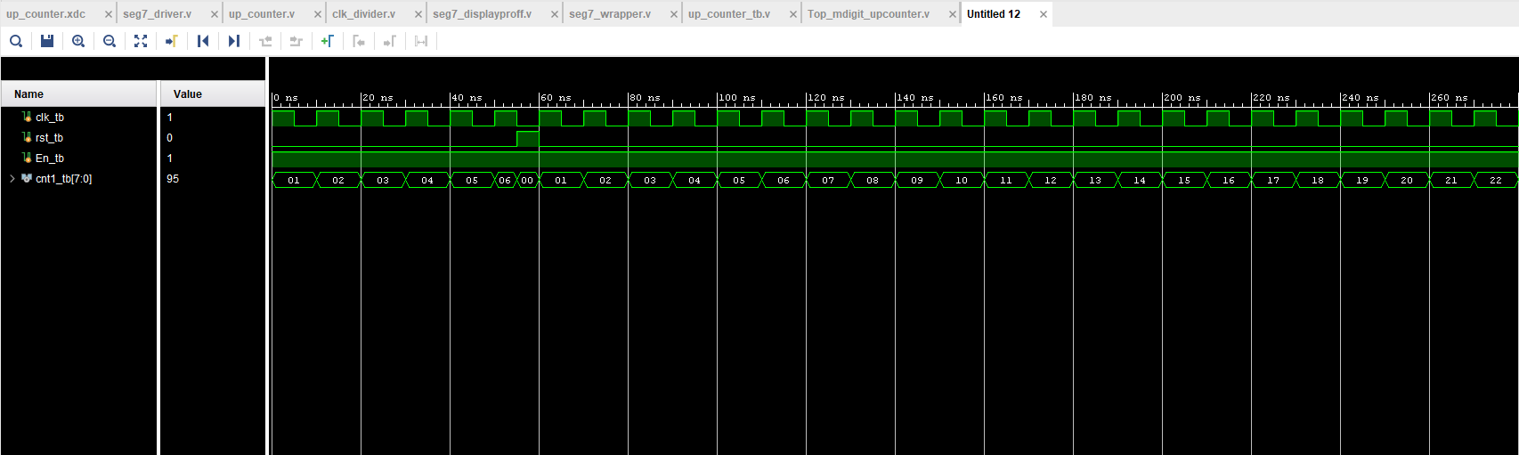
Test Bench

Slide 8
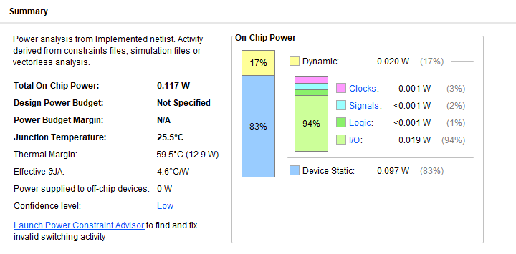
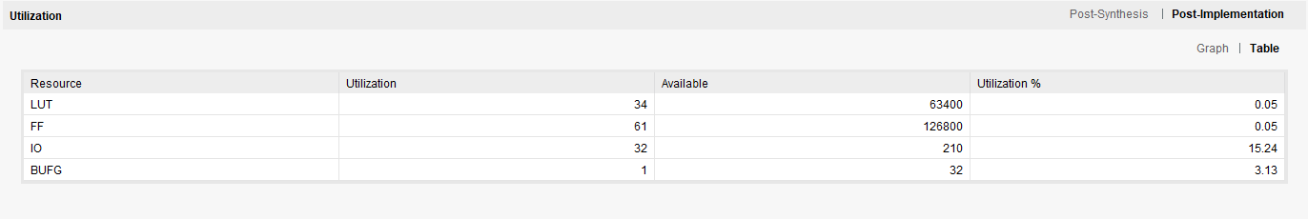
Utilization & Power Summary

